Slide 1
Python module and packages
By sneha solanki(240160510048)

Slide 2
What is module?
A module is simply a Python file (with a .py extension) that contains Python code.
It helps organize and modularize the code, making it more maintainable, reusable, and scalable.

Slide 3
How module works
Creating a Module:
Create a .py file containing functions, classes, and variables.
Example: math_module.py

Slide 4
How module works cont..
Using a Module:
Import the module using import module_name
Example: import math_module

Slide 5
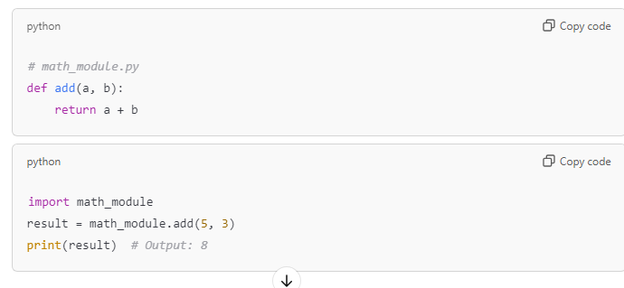
How module works cont..

Slide 6
Benefits to using module
Reusability: Write code once, use it anywhere.
Encapsulation: Hide implementation details.
Maintainability: Easy to modify without affecting the entire codebase.
Namespace Management: Avoid name conflicts by encapsulating variables and functions within a module.

Slide 7
What is package?
A package is a collection of modules grouped together under a common directory.
Packages contain multiple modules and often have an __init__.py file to initialize the package.

Slide 8
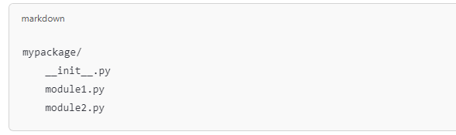
Package structure
Directory Structure:-
The __init__.py file: Marks the directory as a package. It can be empty or execute initialization code for the package.

Slide 9
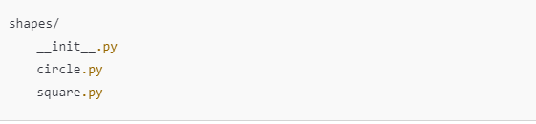
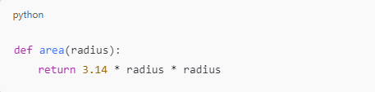
Creating a package
Example: Create a Package shapes:
circle.py:

Slide 10
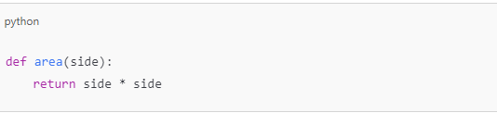
Creating a package cont..
square.py

Slide 11
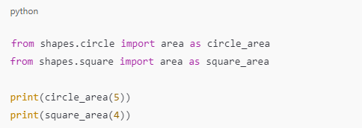
Using packages

Slide 12
Benefits of packages
Organized Code: Group related modules together.
Namespace Management: Avoid name conflicts by separating code into submodules.
Easy Distribution: Share a complete set of related modules as a single package.

Slide 13
Difference between module and package
Feature | module | package
Definition | A single Python file (.py) | A directory containing multiple modules and __init__.py
Size | Generally small and focused on a specific functionality | Used for larger collections of related modules
Structure | One .py file | Directory with multiple .py files and an __init__.py file
Usage | To organize code into a single file | To group related modules together in a namespace
Example | math_operations.py | shapes/ (with modules circle.py and square.py)

